Slide 1
INTERNET OF THINGS
TASK 3: IOT PROTOTYPE WITH ARDUINO
AND
SMART DOOR LOCK SYSTEM
CODE :
#include <Keypad.h>
#include <Servo.h>
#include <Wire.h>
#include <LiquidCrystal_I2C.h>
// LCD address: commonly 0x27
LiquidCrystal_I2C lcd(0x27, 16, 2);
// Servo and buzzer pins
const int servoPin = 10;
const int buzzerPin = 11;

Slide 2
// Keypad configuration
const byte ROWS = 4;
const byte COLS = 4;
char keys[ROWS][COLS] = {
{'1', '2', '3', 'A'},
{'4', '5', '6', 'B'},
{'7', '8', '9', 'C'},
{'*', '0', '#', 'D’}
};
byte rowPins[ROWS] = {9, 8, 7, 6};
byte colPins[COLS] = {5, 4, 3, 2};
Keypad keypad = Keypad(
makeKeymap(keys),
rowPins,
colPins,
ROWS,
COLS
);

Slide 3
// Password
String password = "1234";
String enteredPassword = "";
void setup() {
Serial.begin(9600);
pinMode(buzzerPin, OUTPUT);
doorServo.attach(servoPin);
doorServo.write(0); // Door locked
lcd.init();
lcd.backlight();
lcd.setCursor(0, 0);
lcd.print(" SMART DOOR LOCK");
lcd.setCursor(0, 1);
lcd.print("Door: LOCKED");
delay(2000);
showMessage();
}

Slide 4
void loop() {
char key = keypad.getKey();
if (key) {
// Enter numeric password
if (key >= '0' && key <= '9') {
if (enteredPassword.length() < 4) {
enteredPassword += key;
lcd.clear();
lcd.setCursor(0, 0);
lcd.print("Enter Password:");
lcd.setCursor(0, 1);
for (int i = 0; i < enteredPassword.length(); i++)
{
lcd.print('*');
}
}
}

Slide 5
// Clear password
else if (key == '*') {
enteredPassword = "";
showMessage();
}
// Check password
else if (key == '#') {
lcd.clear();
if (enteredPassword == password) {
lcd.setCursor(0, 0);
lcd.print("Correct Password");
lcd.setCursor(0, 1);
lcd.print("Door Unlocked");
tone(buzzerPin, 1000, 200);
doorServo.write(90);
Serial.println("Access Granted");
Serial.println("Door Unlocked");
delay(5000);

Slide 6
doorServo.write(0);
lcd.clear();
lcd.setCursor(0, 0);
lcd.print("Door Locked");
Serial.println("Door Locked");
delay(1500);
} else {
lcd.setCursor(0, 0);
lcd.print("Wrong Password");
lcd.setCursor(0, 1);
lcd.print("Access Denied");
tone(buzzerPin, 500, 1000);
Serial.println("Access Denied");
delay(1500);
}
noTone(buzzerPin);
enteredPassword = "";
showMessage();
}

Slide 7
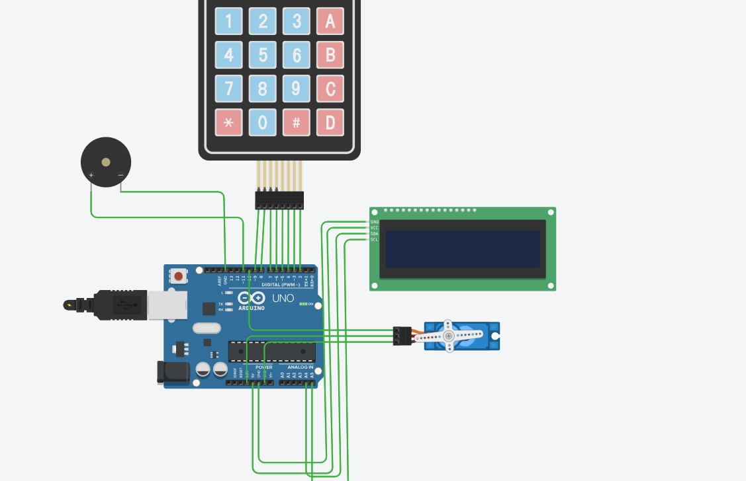
}
}
void showMessage() {
lcd.clear();
lcd.setCursor(0, 0);
lcd.print("Enter Password:");
lcd.setCursor(0, 1);
lcd.print("*=Clear #=Enter");
}
CIRCUIT DIAGRAM:

Slide 8
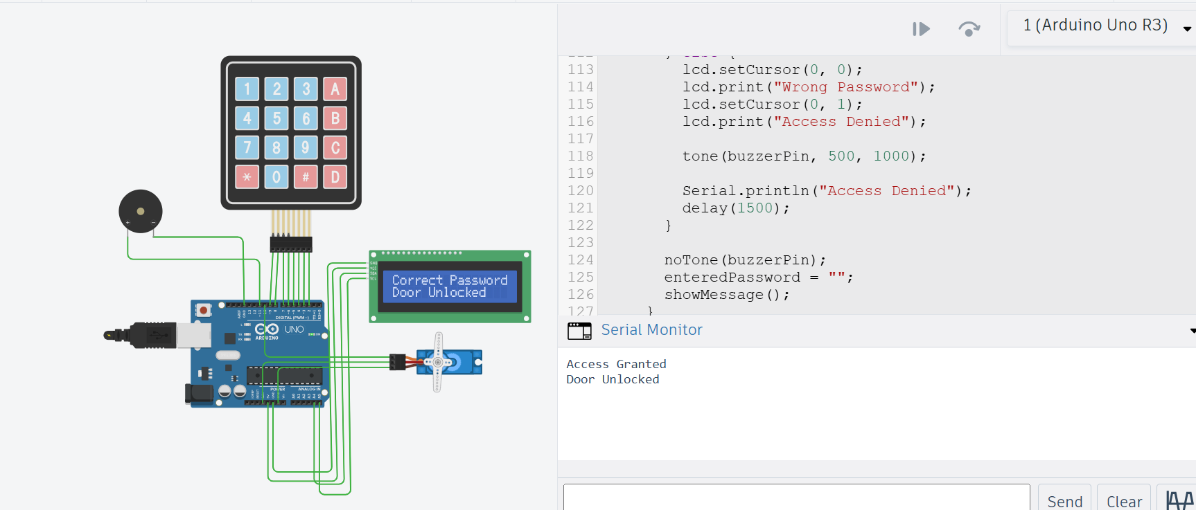
OUT PUT :

